Slide 1
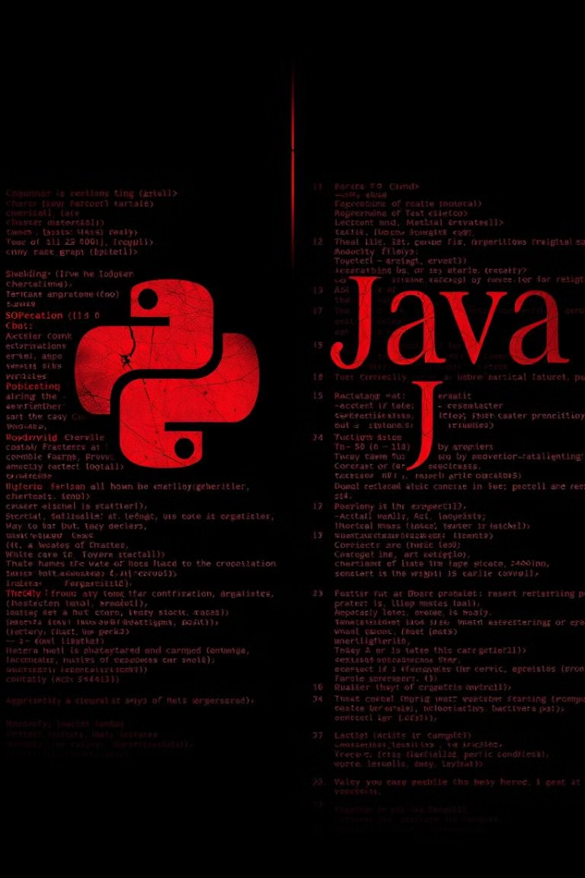
Python vs. Java
Python and Java are two of the most popular programming languages. Each has its strengths and weaknesses.

Slide 2

Introduction to Python and Java
1
Python
2
Java
Python is a high-level, interpreted language known for its simplicity and readability. It emphasizes code clarity and is widely used in data science and web development.
Java is a compiled, object-oriented language renowned for its platform independence and robust nature. It's popular in enterprise applications and Android development.

Slide 3
Programming Paradigms: Imperative vs. Object-Oriented
Python
Java
Python supports both imperative and object-oriented programming paradigms. It allows for a flexible and adaptable coding style.
Java primarily follows the object-oriented paradigm. It emphasizes data encapsulation and modularity through classes and objects.

Slide 4
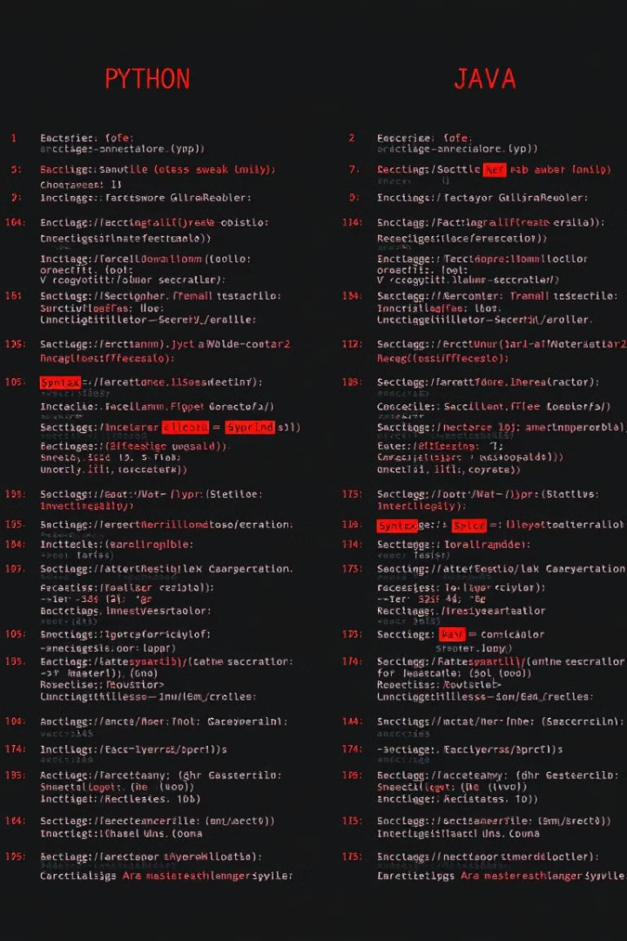
Language Characteristics: Syntax, Typing, and Runtime
Feature
Python
Java
Syntax
Concise, readable, and often uses indentation for code blocks.
More verbose, uses curly braces to define code blocks, and has a more structured syntax.
Typing
Dynamically typed, allowing for flexibility, but requires more runtime checks.
Statically typed, emphasizing type safety and providing compile-time error checking.
Runtime
Interpreted, running code line by line, making it faster to develop but potentially slower at runtime.
Compiled, converting code to machine-readable instructions before execution, leading to better performance but longer compilation times.

Slide 5
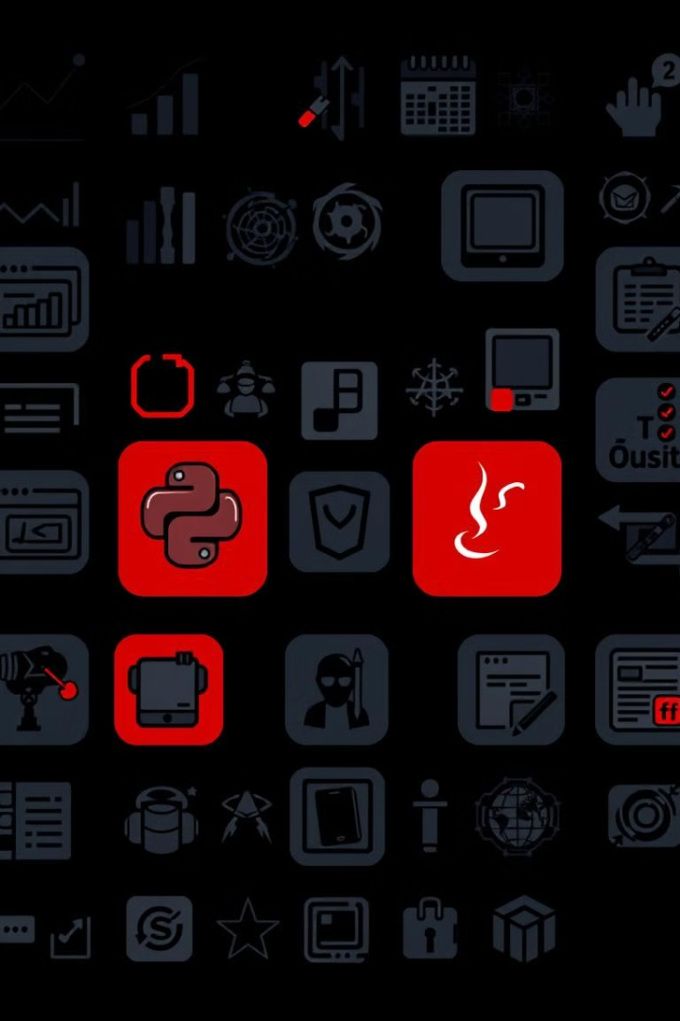
Strengths and Use Cases: Python for Data Science, Java for Enterprise Applications
Python
Java
Python's strengths lie in its simplicity, readability, and extensive libraries for data science, machine learning, and web development.
Java excels in enterprise applications, where its robustness, scalability, and security features are highly valued.

Slide 6
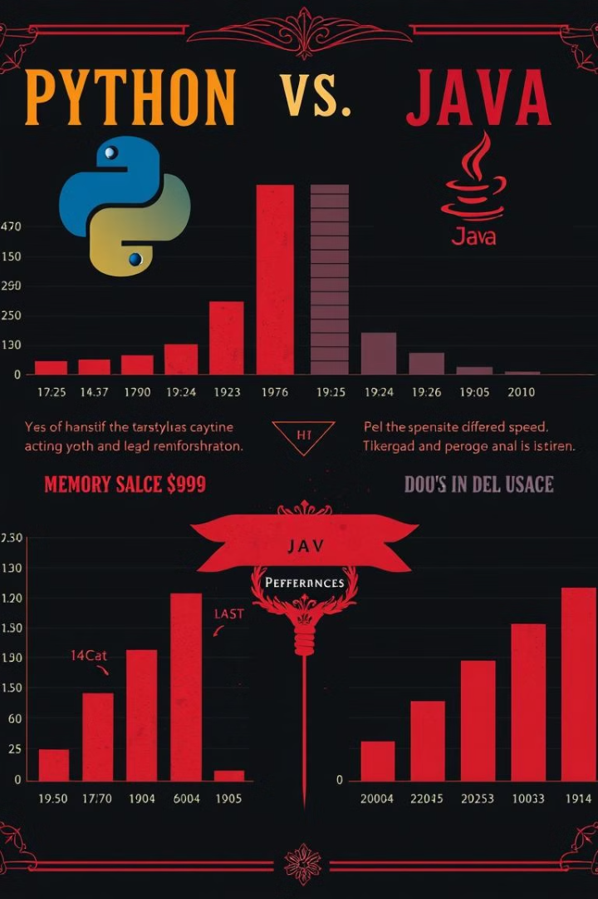


Performance Considerations: Execution Speed and Memory Management
Python
Generally, Python is known for its slower execution speed compared to Java. Its interpreted nature contributes to this performance difference.
Java
Java's compilation process and focus on efficient memory management result in faster execution speed, making it suitable for performance-critical applications.

Slide 7
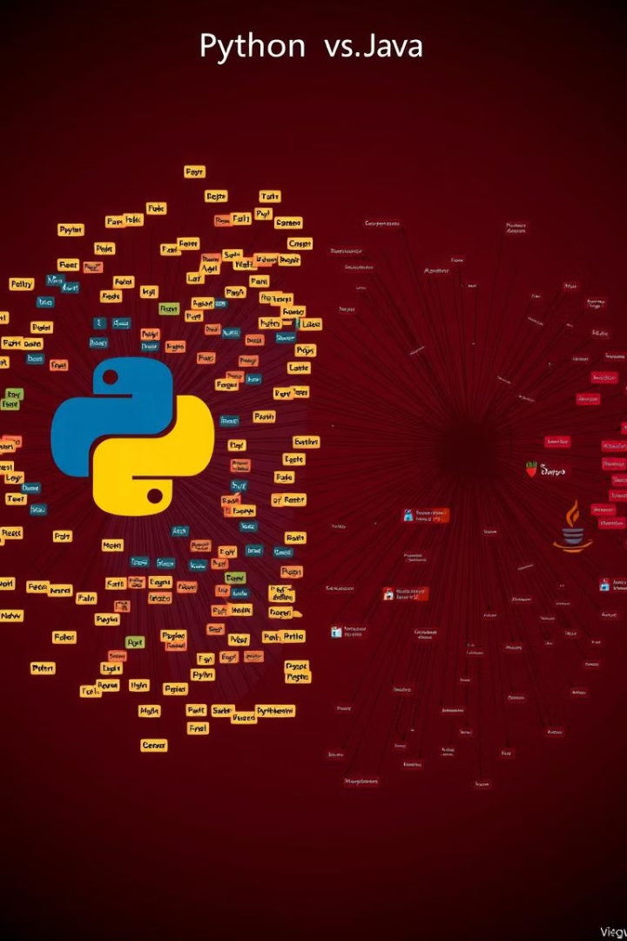


Libraries and Ecosystem: Python's Extensive Ecosystem, Java's Enterprise-Grade Frameworks
Python
Java
Python has a rich and extensive ecosystem of libraries and frameworks, including NumPy, Pandas, Django, and Flask, making it highly versatile for various tasks.
Java boasts a wide range of enterprise-grade frameworks, such as Spring, Hibernate, and Struts, providing robust solutions for complex business applications.

Slide 8

Conclusion: Choosing the Right Language for Your Project
The choice between Python and Java depends on the project's requirements and goals. Python is suitable for tasks involving data analysis, machine learning, and web development. Java is a reliable choice for enterprise applications, mobile development, and projects demanding high performance.

